Slide 1
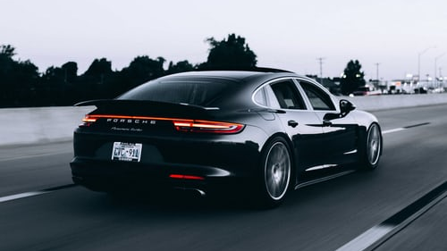

Project
By:- Rituraj Sharma

Slide 2
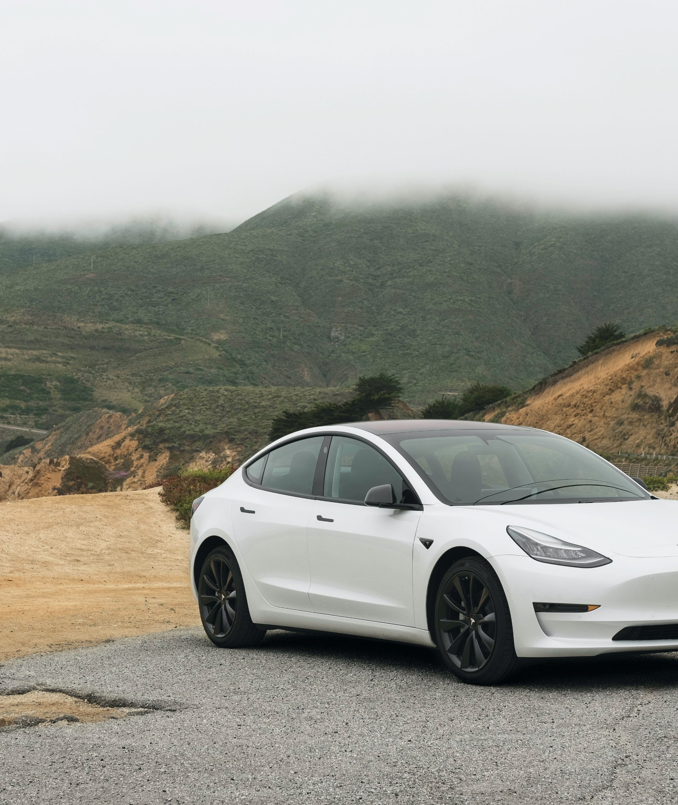
Overview about the dataset
Uber Technologies, Inc. is an American technology company founded in 2009 that revolutionized transportation through its ride-hailing app, connecting riders with drivers. It operates in over 70 countries and offers services like UberX, Uber Black, Uber Eats (food delivery), and Uber Freight (logistics).
Uber uses advanced technology like GPS, machine learning, and dynamic pricing to optimize services. Despite its global success, it faces challenges like regulatory scrutiny, competition, and debates over driver classification. As a public company since 2019, Uber continues to expand into autonomous vehicles, electric mobility, and other innovative transportation solutions.

Slide 3
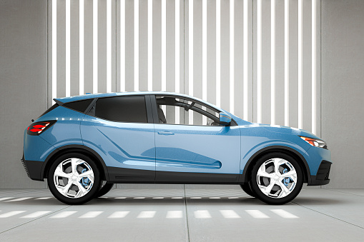
Queries
What is the distribution of trip durations?
What is the average trip duration for each hour of the day?
How does the number of trips vary by hour of the day?
What is the distribution of trip purposes?
What is the relationship between miles driven and trip duration?
What is the distribution of trip distances?
Cabs in 2008

Slide 4
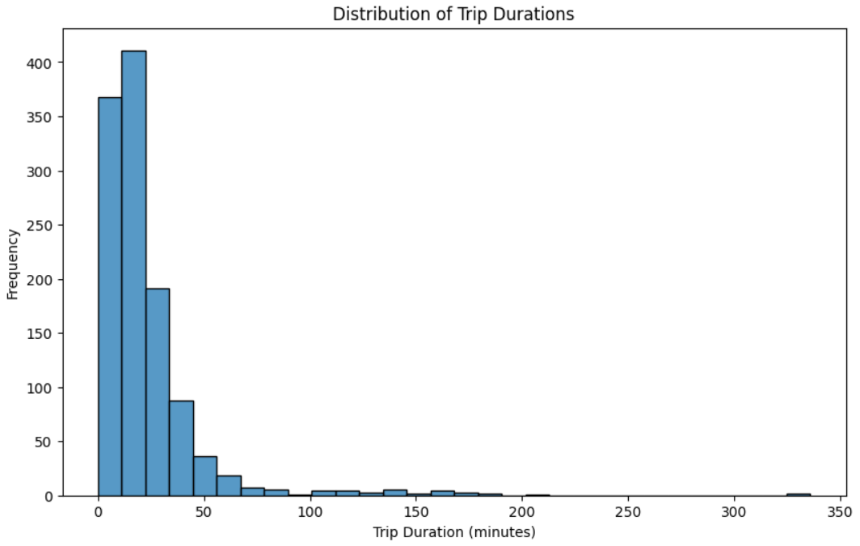
Q.1 What is the distribution of trip durations?
Trip durations are mostly short, with a majority of trips falling under 20 minutes. There are also some longer trips but they are far less frequent, indicating most Uber rides in the dataset are for relatively short distances. The distribution is right-skewed, which is expected as trip durations cannot be negative and there's a natural limit to how long a single trip can be

Slide 5
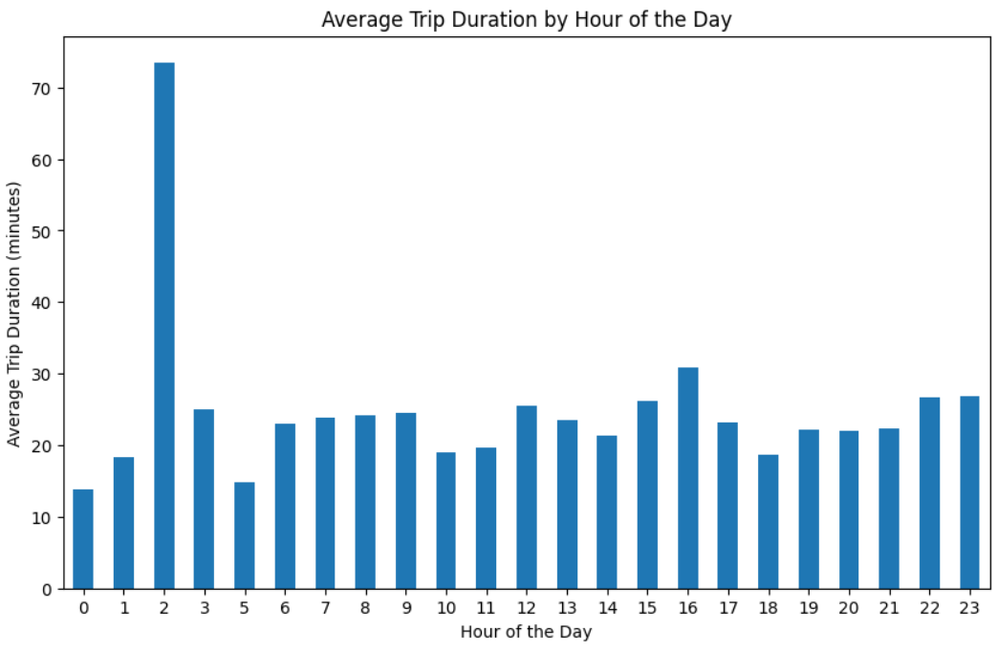
Q.2 What is the average trip duration for each hour of the day?
Average trip duration tends to be higher during the early morning hours (around 5-6 AM). This could potentially be due to less traffic congestion, allowing for faster travel. During peak commuting hours (8-9 AM and 5-6 PM) , the average trip duration is relatively lower.

Slide 6
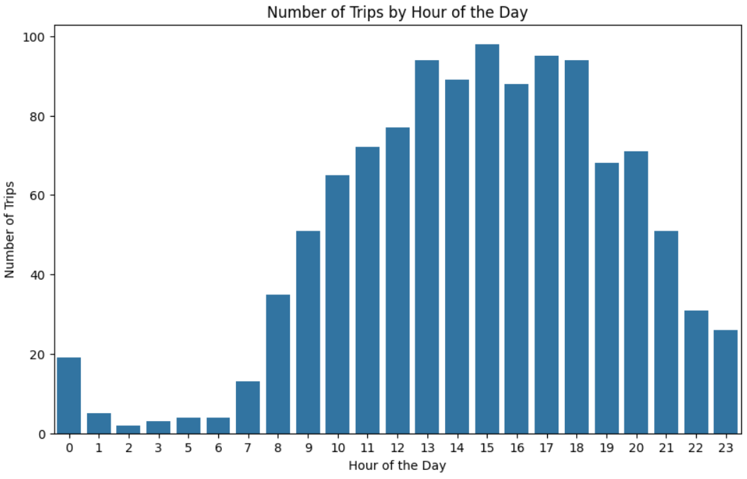
Q.3 How does the number of trips vary by hour of the day?
The number of trips is highest during the typical commuting hours (8-9 AM and 5-6 PM). There is also a surge in the number of trips during the evening hours (around 6 PM), suggesting people use Uber for leisure or social activities after work. The least number of trips occur in the very early morning hours when most people are asleep.

Slide 7
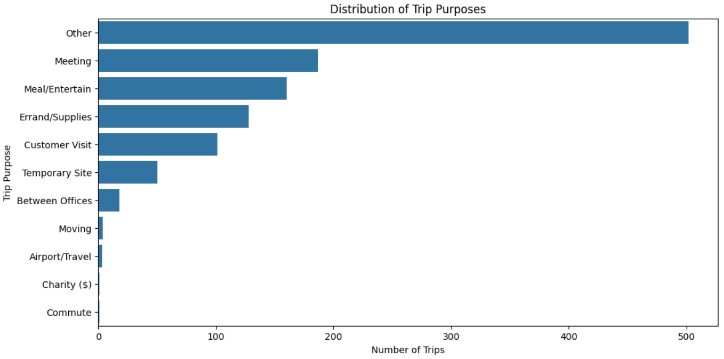
Q.4 What is the distribution of trip purposes?
A significant majority of trips are for business purposes, indicating Uber is predominantly used for work-related travel. Personal trips, meetings, and meal/entertainment related trips, and customer visits constitute a smaller portion of the overall trip distribution. There's also a noticeable 'Other' category indicating trips with unspecified purposes.

Slide 8
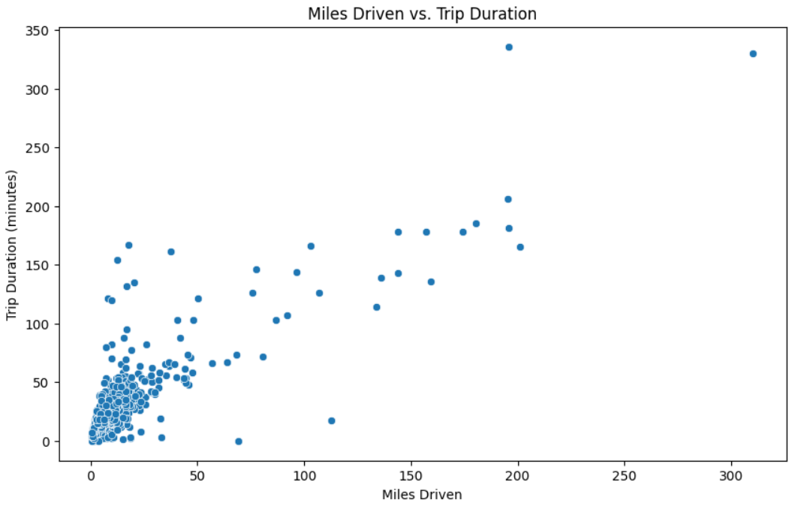
Q.5 What is the relationship between miles driven and trip duration?
There's a positive correlation between miles driven and trip duration. As the distance traveled increases, the trip duration generally increases as well. However, this relationship is not strictly linear. There are trips with short distances and longer durations, likely due to traffic or other factors that slow down the journey.

Slide 9
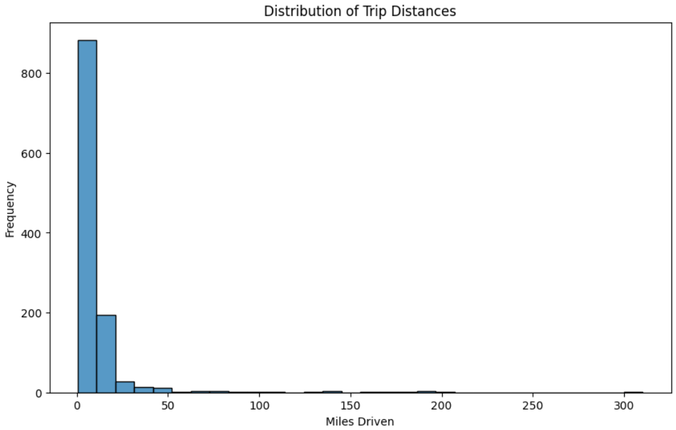
Q.6 What is the distribution of trip distances?
Similar to trip durations, trip distances are mostly short with a majority under 10 miles. The distribution is also right-skewed, with a long tail implying the presence of a few longer distance trips. This reaffirms the finding that Uber usage in the dataset predominantly consists of shorter trips within a city or metropolitan area.

Slide 10
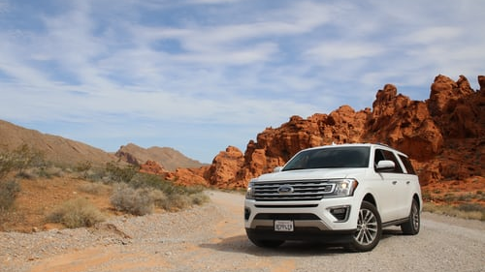
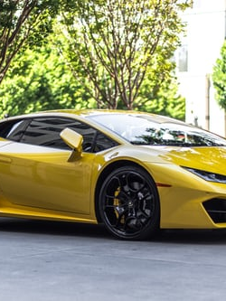


Conclusion
The conclusion is that the service is primarily used for short-distance trips, mainly for business purposes. This is evident from the distribution of trip durations and distances, which are heavily skewed towards shorter trips. Most rides are under 20 minutes and cover less than 10 miles. The peak usage times align with typical commuting hours, further emphasizing its role in work-related travel.
While trips for personal use and other reasons exist, they are less common compared to business-related trips. The data suggests that within the timeframe and location covered by this dataset, Uber serves as a significant transportation option for professionals and businesses.
Additionally, there's a noticeable impact of time and traffic on trip durations. Trips during early morning hours tend to have longer durations potentially due to reduced traffic, while peak hours might lead to slightly shorter but potentially more frequent trips.

Slide 11
Thank You

